Slide 1
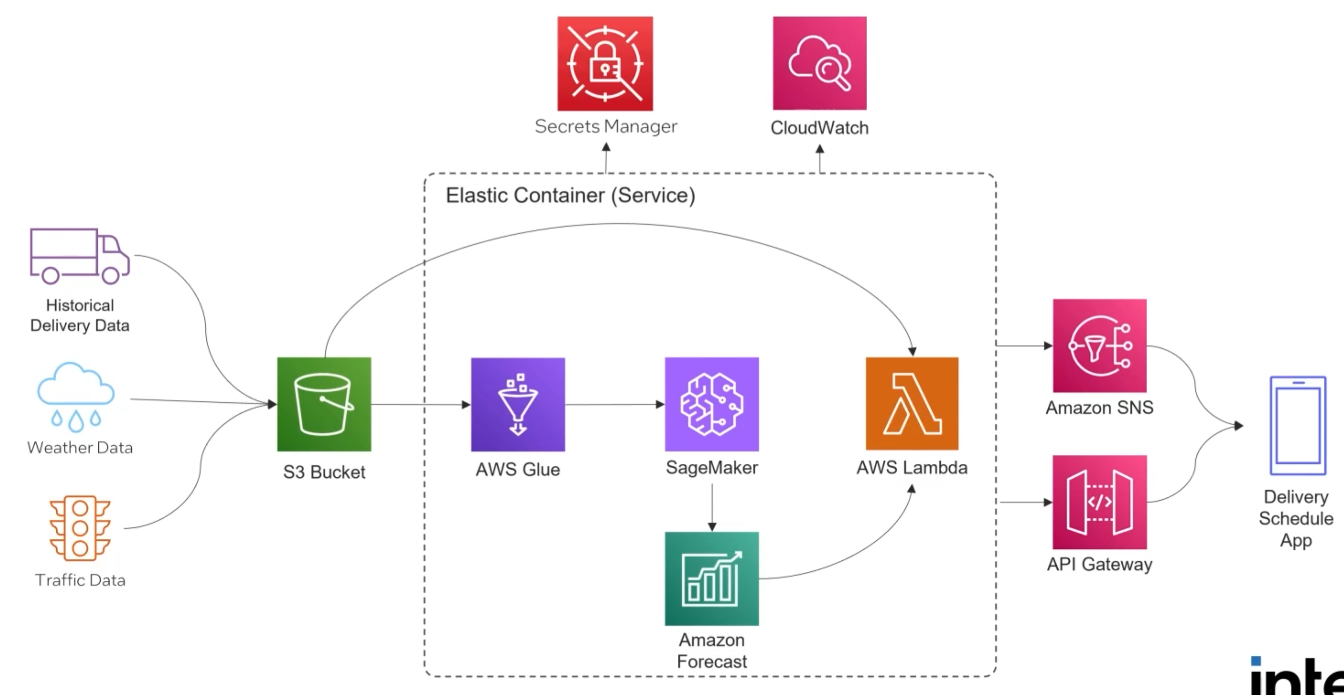
Delivery Schedule Optimization

